Slide 1









Whiteboardmaths.com
7
2
1
5
© 2004 All rights reserved

Slide 2
Area of a Segment
Major Segment
Major Segment
O
A
B
A
B
Minor Segment
Minor Segment
Area of minor segment = Area of sector AOB - Area of triangle AOB

Slide 3
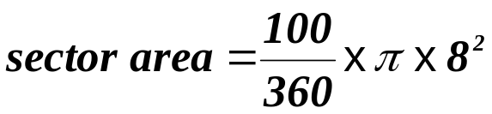

Example Question 1: Find the area of the minor segment in the circle below.
Not to SCALE
O
O
100º
8 cm
8 cm
50º
8 cm
h
A
B
A
B
12.2 cm
M
6.1 cm
h² = 8² - 6.1² (Pythagoras)
h = √(8² - 6.1²)
= 5.18 cm
Alternatively use ½ absinC for area of triangle.
½ x 8² x sin 100º = 31.5 cm²
Area of triangle AOB = ½ (12.2 x 5.18) = 31.60 cm²
Segment area = 55.85 – 31.60 = 24.3 cm² (1 dp)
Why are the answers slightly different?

Slide 4
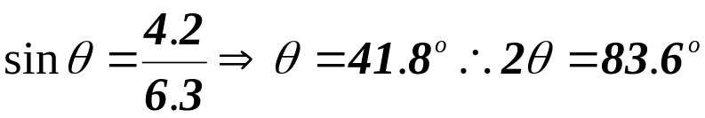
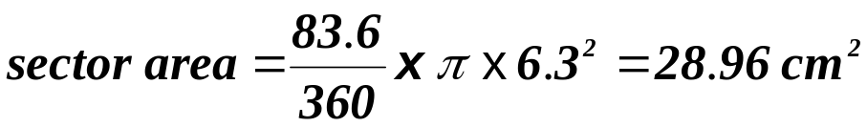
Example Question 2: Find the area of the minor segment in the circle below.
Not to SCALE
O
O
6.3 cm
θ
6.3 cm
83.6º
h
A
B
A
B
8.4 cm
M
4.2 cm
Angle AOB is needed to calculate the sector area.
h² = 6.3² - 4.2² (Pythagoras)
h = √(6.3² - 4.2²)
= 4.70 cm
Alternatively use ½ absinC for area of triangle.
Area of triangle AOB = ½ (8.4 x 4.70) = 19.74 cm²
Segment area = 28.96 - 19.74 = 9.2 cm² (1 dp)
½ x 6.3² x sin 83.6º = 19.72 cm²

Slide 5

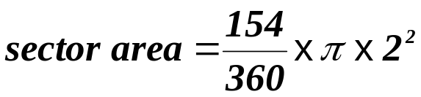

Question 1: Find the cross-sectional area of the water in the cylindrical pipe.
Not to SCALE
O
O
2 m
2 m
154º
h
77º
A
3.9 m
B
A
M
1.95 m
B
12.2 cm
12.2 cm
h² = 2² - 1.95² (Pythagoras)
h = √(2² - 1.95²)
= 0.44 m
Alternatively use ½ absinC for area of triangle.
Area of triangle AOB = ½ (3.9 x 0.44) = 0.86 m²
Segment area = 5.38 - 0.86 = 4.4 m² (1 dp)
½ x 2² x sin 154º = 0.88 cm²

Slide 6
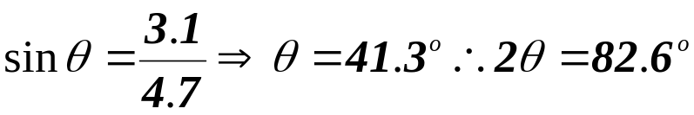
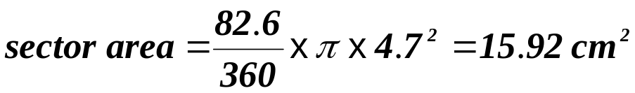
Question 2: Find the area of the minor segment in the circle below.
Not to SCALE
O
O
4.7 cm
θ
4.7 cm
82.6º
h
A
B
A
B
6.2 cm
M
3.1 cm
Angle AOB is needed to calculate the sector area.
h² = 4.7² - 3.1² (Pythagoras)
h = √(4.7² - 3.1²)
= 3.53 cm
Alternatively use ½ absinC for area of triangle.
Area of triangle AOB = ½ (6.2 x 3.53) = 10.94 cm²
Segment area = 15.92 - 10.94 = 5.0 cm² (1 dp)
½ x 4.7² x sin 82.6º = 10.95 cm²

Slide 7
Worksheets
2
1
O
O
100º
8 cm
6.3 cm
A
B
A
B
12.2 cm
8.4 cm

Slide 8
1
2
154º
O
O
2 m
4.7 cm
A
3.9 m
B
A
B
12.2 cm
6.2 cm

